Slide 1
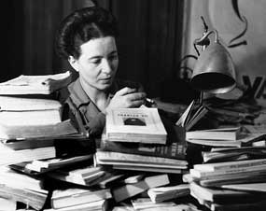
Reading The Second Sex the Third Time: On the Quiet, Queer Genius of the Beauvoirean “Second”
Kyoo Lee
(City University of New York)

Slide 3
Wait a Second,
Why the Second?
What “the second” is/means/does/becomes in and after the second sex: its potential (pouvoir).

Slide 4
Intro\ Complicated Coordinates
Thus humanity is male and man defines woman not in herself but as relative to him; she is not regarded as an autonomous being. . . . For him she is sex—absolute sex, no less. She is defined and differentiated with reference to man and not he with reference to her; she is the incidental, the inessential as opposed to the essential. He is the Subject, he is the Absolute—she is the Other.
The category of the Other is as primordial as consciousness itself. In the most primitive societies, in the most ancient mythologies, one finds the expression of a duality—that of the Self and the Other. (xlv)

Slide 5
Intro\Ironic Perfection?
Some say that, having been created after Adam, she is evidently a secondary being; others say on the contrary that Adam was only a rough draft and that God succeeded in producing the human being in perfection when He created Eve. (lvii, emphasis mine.)

Slide 6
Intro\In Search of an Angel
Evidently indeed, this vexing “woman question,” which “masculine arrogance,” so blindly gendered, turned into a “quarrel,” would require the impartial judge, “an angel—neither man nor woman—but where shall we find one?” (LVII)

Slide 7
1/3: ORDINAL: The Second(ary) POSITION
So not every female human being is necessarily a woman; she must take part in this mysterious and endangered reality known as femininity. Is femininity secreted by the ovaries? Is it enshrined in a Platonic heaven? Is a frilly petticoat enough to bring it down to earth? Although some women zealously strive to embody it, the model has never been patented. It is typically described in vague and shimmering terms borrowed from a clairvoyant’s vocabulary. … But conceptualism has lost ground: biological and social sciences no longer believe there are immutably determined entities that define given characteristics like those of the woman, the Jew, or the black; science considers characteristics as secondary reactions to a situation. If there is no such thing today as femininity, it is because there never was. (3-4)

Slide 8
1/3: Ordinal\PRIMAL
… an affinity between woman and the elements as primal as sexuality itself (175)

Slide 9
2/3: Contractual: THE SECOND PERSON
Refusing to be the Other, refusing complicity with man, would mean renouncing all the advantages an alliance with the superior caste confers on them … The man who sets the woman up as an Other will thus find in her a deep complicity. Hence woman makes no claim for herself as subject because she lacks the concrete means, because she senses the necessary link connecting her to man without positing its reciprocity, and because she often derives satisfaction from her role as Other.
But a question immediately arises: How did this whole story begin? It is understandable that the duality of the sexes, like all duality, be expressed in conflict. It is understandable that if one of the two succeeded in imposing its superiority, it had to establish itself as absolute. It remains to be explained how it was that man won at the outset. (10)

Slide 10
2/3: Contractual \The-An Other: Twinship
a man can reveal to her the existence for itself of her flesh, but not what it is for an other. It is only when her fingers caress a woman’s body whose fingers in turn caress her body that the miracle of the mirror takes place. (429)

Slide 11
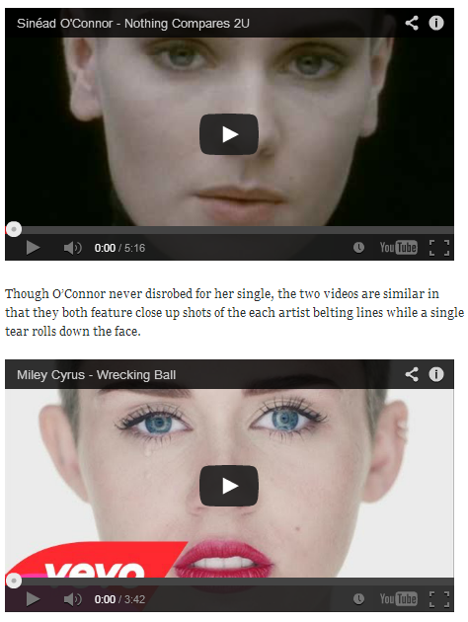

Slide 12
3/3: Sequential: the SECOND Be/Coming
On ne naît pas femme: on le devient .
“One is not born, but rather becomes, a woman." (1953)
"One is not born, but rather becomes, woman.” (2009)
“One is not born femme ([a] woman/female/feminine); one becomes so/that/it (le).”

Slide 13
3/3: Sequential\ Serially Subversive
On ne naît pas femme: on le devient .
On ne naît pas femme: on le deviant?

Slide 14
SUM
Ordinal\ Primal
Contractual\ Convoluted
Sequential\ Serially Subversive
Second to None:
Singular,
Transitive,
Transformative,
Transgenerative

